Slide 1

  NIMS UNIVERSITY RAJASTHAN JAIPUR
Marik Institute of Computing, Artificial Intelligence, Robotics & Cybernetics
Card Shield
Suryapal Singh (2024COMPSC0029)
Name of Mentor : Ms. Mohini Fulzele
Lab Name : Cognative Science- Project Based Learning Lab

Slide 2
Contents
Introduction
Abstract
Objective
Outcome
Work plan Schedule
Project submission date
Refe

Slide 3
Introduction
The Problem:
  Today, everyone uses debit and credit cards for shopping and ATM cash withdrawals.
  Because of this, online card fraud, card cloning, and stolen card misuse are rising very fast.
Current Banking Systems:
  Most banks use simple, fixed rules (like daily limits).
  These old rules often block normal users by mistake or fail to catch smart thieves.
Our Solution (CardShield):
  We built CardShield, a smart website powered by Machine Learning.
  It checks transaction details in less than a second and tells if a payment is safe or fraudulent before the money is lost.
Refe

Slide 4
Abstract
Project Summary:
  CardShield is a web-based system that predicts credit and ATM card fraud in real time.
The Big Challenge (The Accuracy Paradox):
  In real bank data, 99.5% of transactions are normal and only 0.5% are fraud.
  If a system simply guesses "Normal" every time, it gets 99.5% accuracy but catches zero frauds!
How We Solved It:
  We trained a Random Forest AI model that focuses specifically on catching rare fraud patterns.
  We check 7 key factors: Card Status, Amount, Time of day, Location (domestic vs. international), Category, Frequency, and Credit Limit.
Results:
  The AI catches 78.4% of frauds with an 86.5% overall quality score (ROC-AUC).
  Gives results in less than 1 second.

Slide 5
Objective
1. Instant Detection:
  Check every transaction in less than 1 second so real shopping is never delayed.
2. Catch Real Frauds:
  Focus on finding actual fraud attempts instead of showing fake high accuracy numbers.
3. Check Multiple Signals:
  Don't look only at money. Check time (like 3 AM), location (foreign countries), and speed (too many transactions in 24 hours).
4. User-Friendly Website:
  Build a clean, easy-to-use dashboard with speed gauges, factor charts, and testing profiles.
5. Automatic Recommendations:
  Tell bank officers what to do: Approve transaction, Send an OTP, or Block the card immediately.

Slide 6
Outcome
1. Working AI Model:
  Trained on 100,000 bank transactions.
  Successfully spots fraud patterns with 78.4% recall (catch rate).
2. Complete Full-Stack Website:
  Frontend: Interactive dashboard with speedometer gauge and risk factor bars.
  Backend: Fast Python Flask server that connects directly to the AI model.
3. Live on Cloud:
  Code uploaded to GitHub and deployed live on the internet via Render.
4. Clear Risk Levels:
  Shows scores from 0 to 100:
    🟢 Very Low / Low Risk (Safe to approve)
    🟡 Medium Risk (Send OTP)
    🔴 High Risk / Fraud (Block the card)

Slide 7
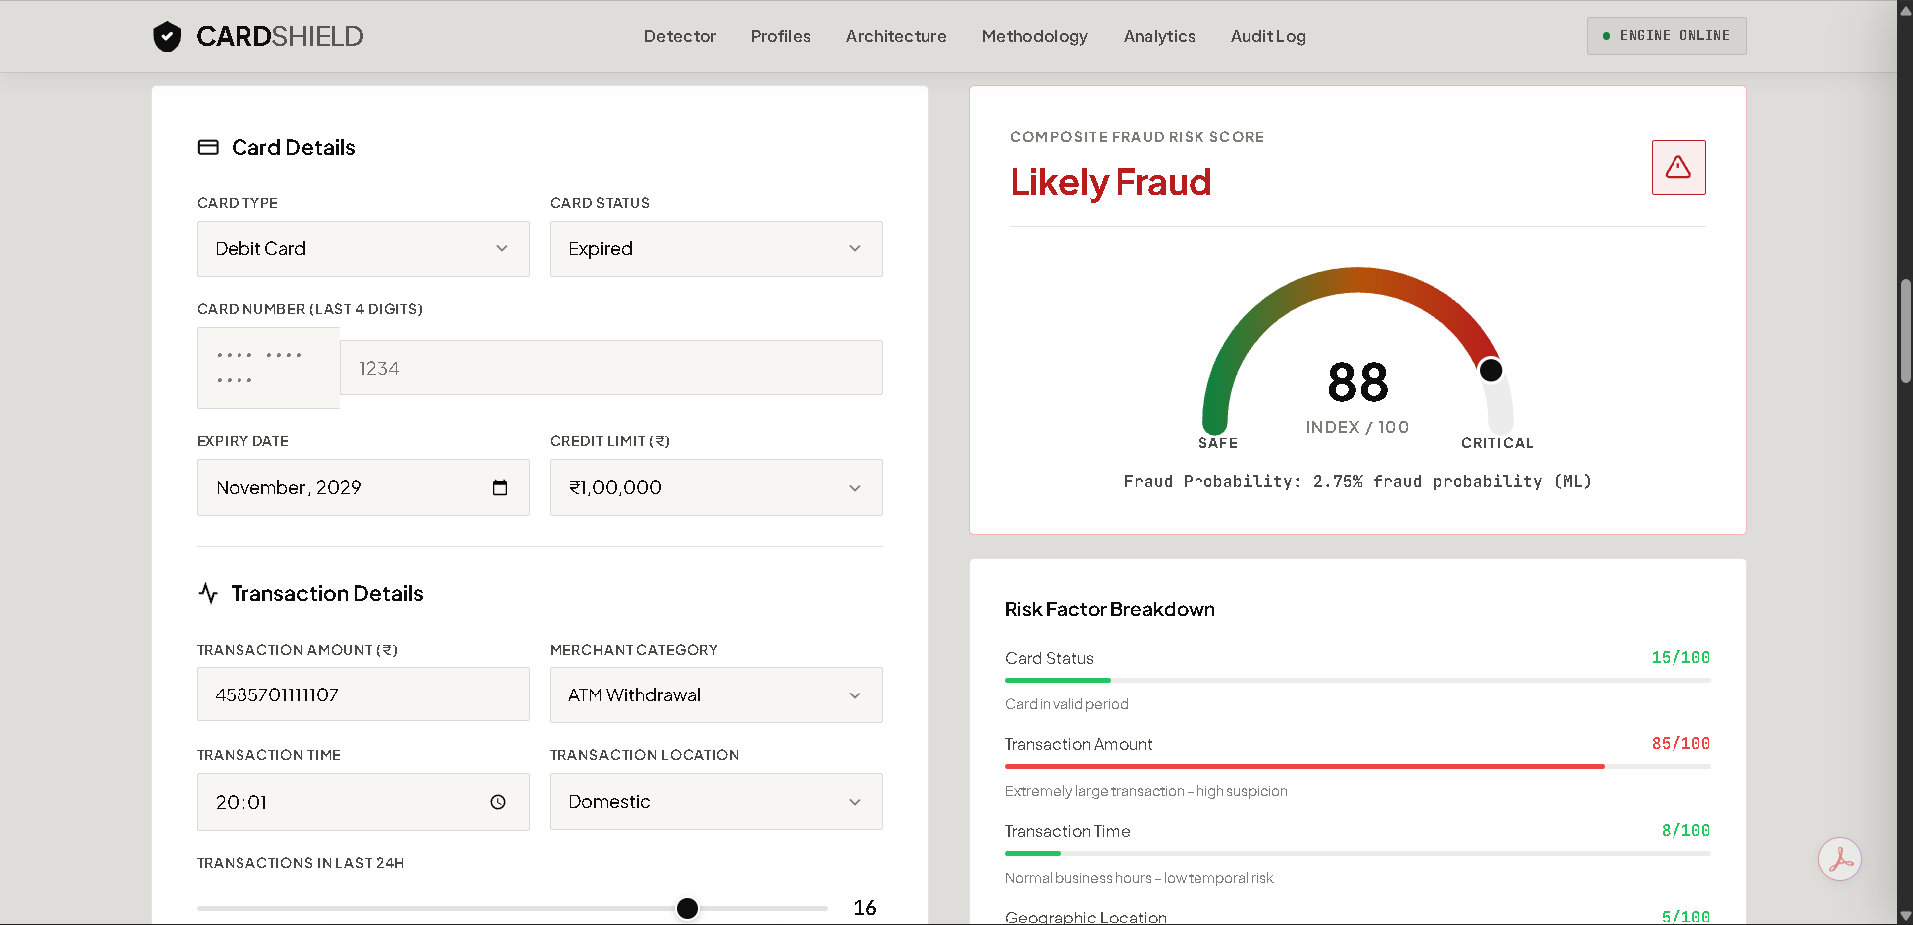
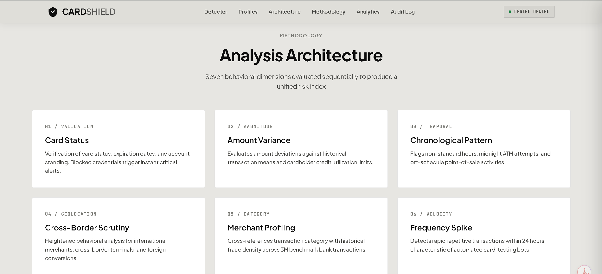
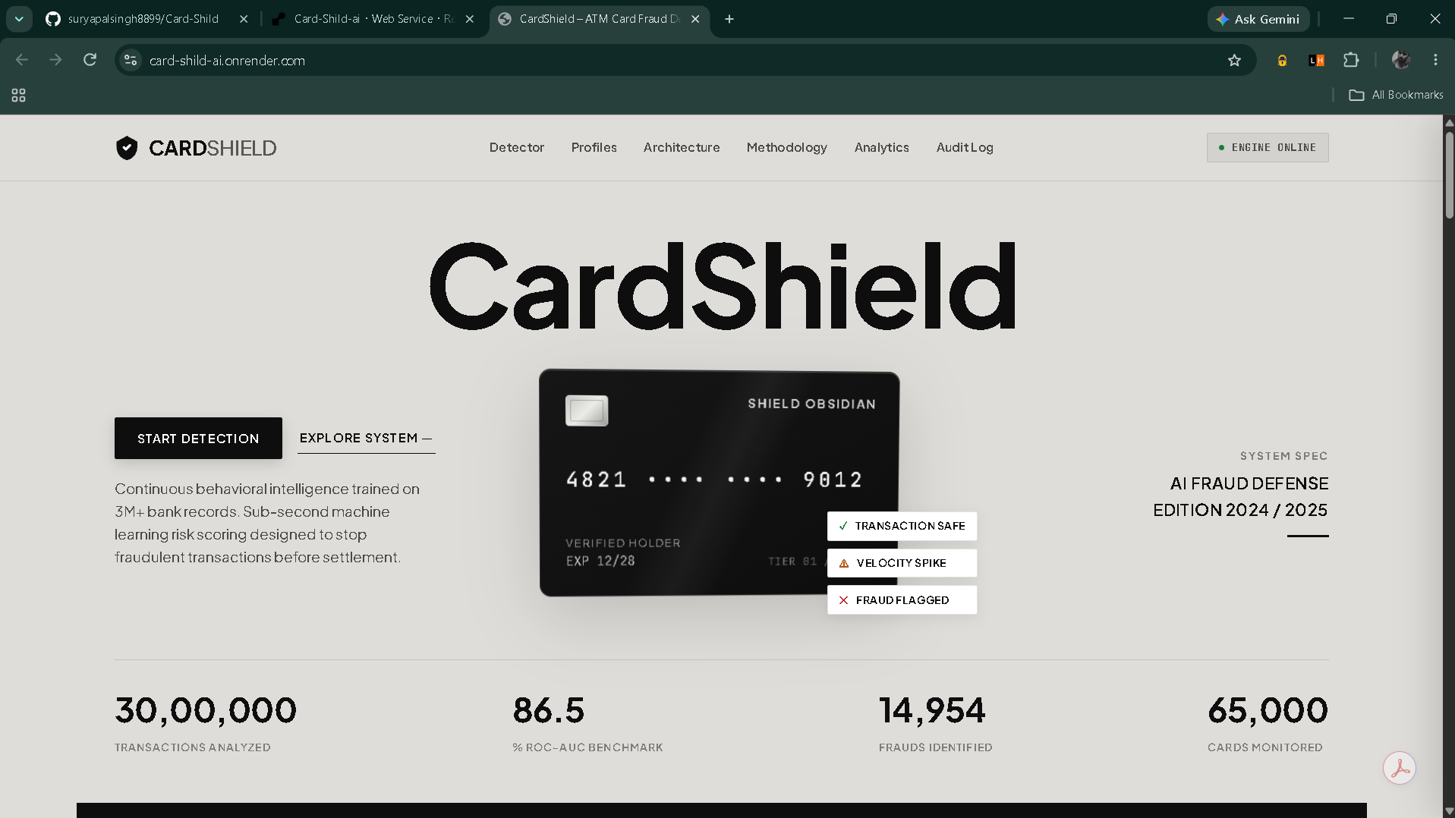
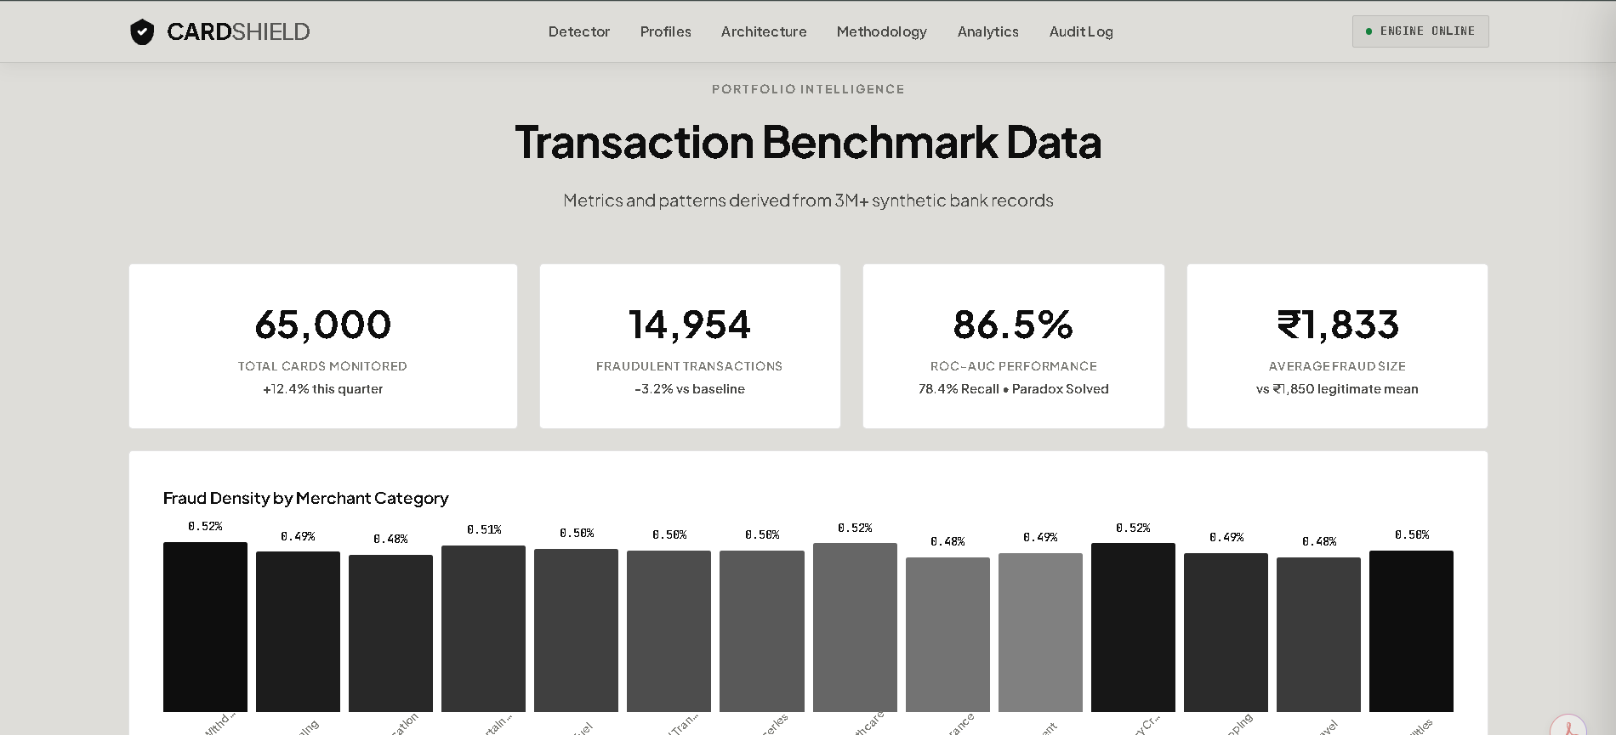
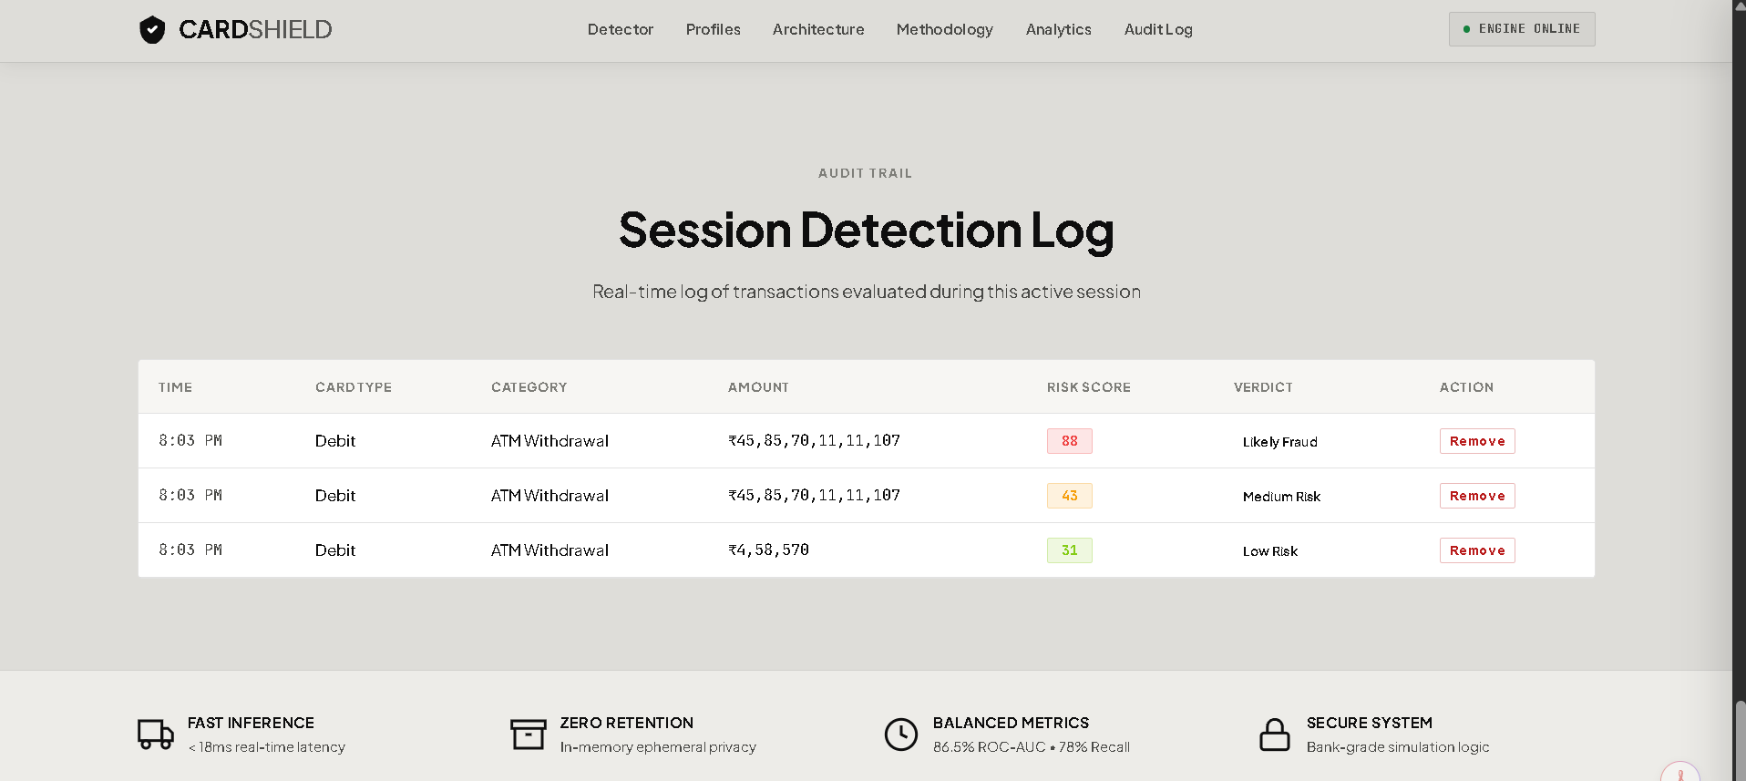
Screen Shots

Slide 8
Work – Plan
Months Activities | Aug 26 | Sep 26 | Oct 26 | Nov 26
Literature Reviews | √
Component Identification & Selection | √
AI Model Training |  | √
Backend Setup |  | √
Designing |  | √
Testing and Debugging |  |  | √
Preparation of Project Report |  |  | √ | √

Slide 9
Project Submission Date & Details
Project Name: CardShield – ATM Card Fraud Detection
Submission Date: November 10, 2026
Student Details:
  Name: Suryapal Singh
  St ID: [146476]
  Branch: BCA 5th Sem
Deliverables Ready:
  ✅ Source Code on GitHub (suryapalsingh8899/Card-Shild)
  ✅ Live Website running on Render
  ✅ Trained AI Model (fraud_model.pkl)
  ✅ Project Report and Documentation

